Slide 1

Web Scraping & Exploratory Data Analysis(EDA) on
Refrigerators from Filpkart
M. Akhil
G. Chandrakanth
G. Shivakumar

Slide 2
What is Web Scraping ? How it works ?
Web Scraping is the process of automatically extracting data from websites using software or scripts.
Instead of manually copying information, web scraping tools collect large amounts of online data quickly and convert it into a structured format such as Excel, CSV, or a database.
How it works
Sends a request to web page
Download the HTML webpage
Extracting required data from webpage
Save the data for analysis

Slide 3
Objective
To extract refrigerator product data such as brand, price, ratings, capacity, and Stars, Doors from Flipkart using web scraping techniques.
To automate data collection from multiple product pages and convert unstructured web data into a structured dataset.
To clean and preprocess the scraped data by handling missing values, removing special characters, and standardizing formats. To perform exploratory data analysis (EDA) to identify price trends, popular brands, and feature distribution among refrigerators.
To demonstrate the use of Python libraries like BeautifulSoup, Requests, Pandas, and Matplotlib/Seaborn for real-time data extraction and analysis.

Slide 4
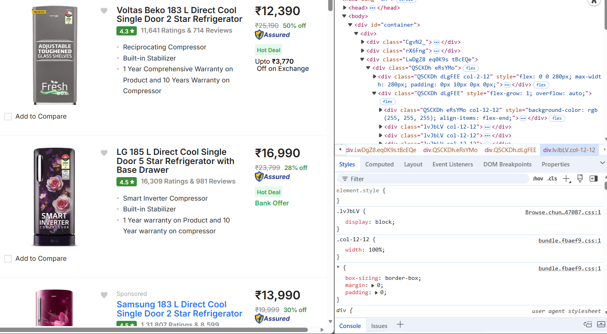
Website
Link- Refrigerator- Buy Products Online at Best Price in India - All Categories | Flipkart.com

Slide 5
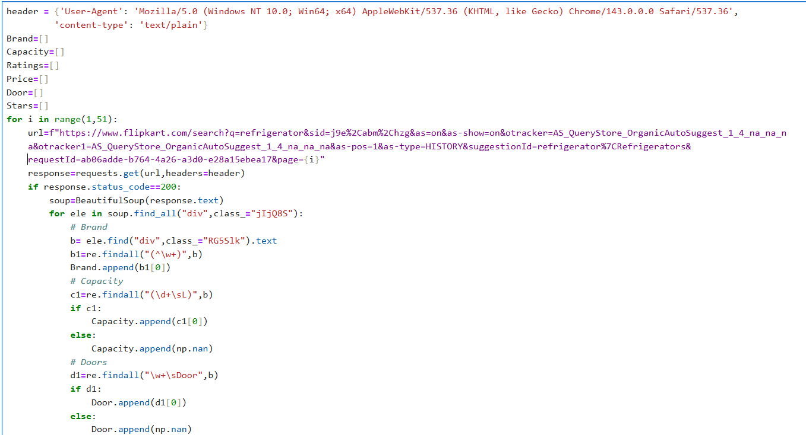

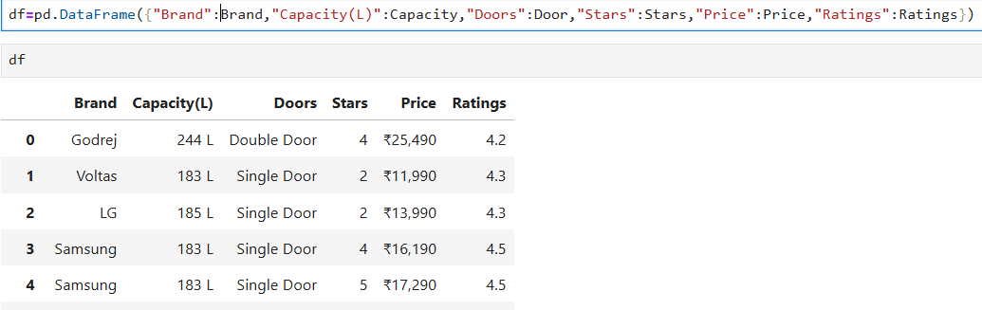
Extracting data for webpage

Slide 6
Data set Overview
The dataset contains 984 rows and 6 columns which contains information about Refrigerators.
Columns include : Brand, Capacity(in L), Door Type, Stars, Price. Ratings.
Data types are 2 categorical and 4 numerical columns.
Categorical variables: Brand , Door Type.
Numerical variables: Capacity(in L), Stars, Price, Ratings

Slide 7
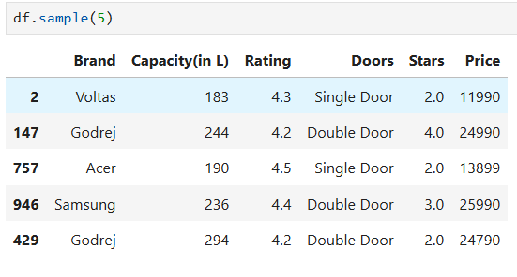
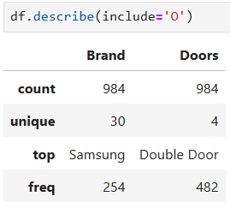
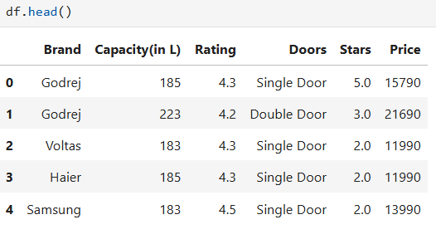
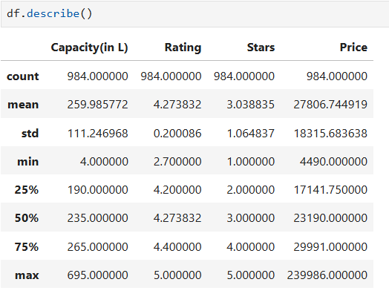

Basic Checks

Slide 8
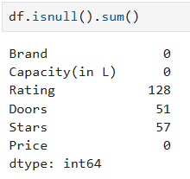
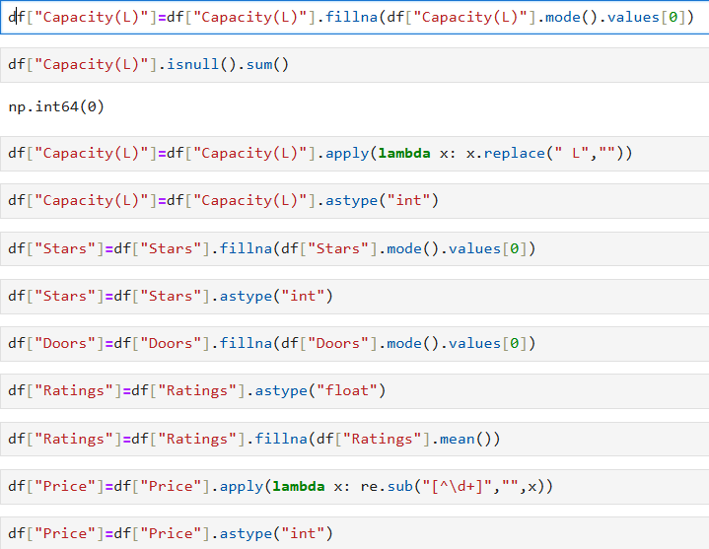
Preprocessing Techniques on Dataset Individual Columns
Checking Null Values
Cleaning of null Value
The data set missing values
The Columns Rating, Doors, Stars have missing values.
The Null Values in the columns are filled by mode, mean of the values in the columns.
The Data extract from webpage it give object data type. So data need to be converted.

Slide 9


Checking Null Values After Preprocessing
The Missing values in the Ratings, Doors, Stars Columns are filled.
The Info Show there are no null values and the data type of the columns are changed.

Slide 10
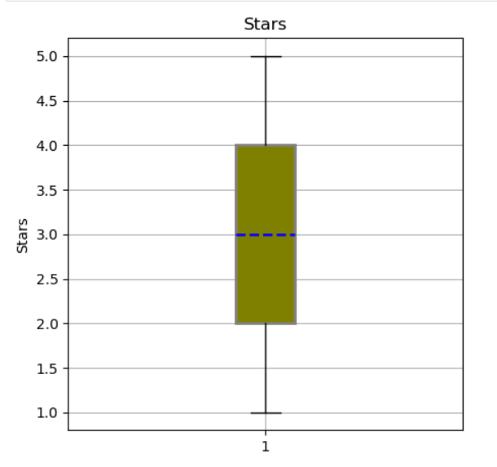
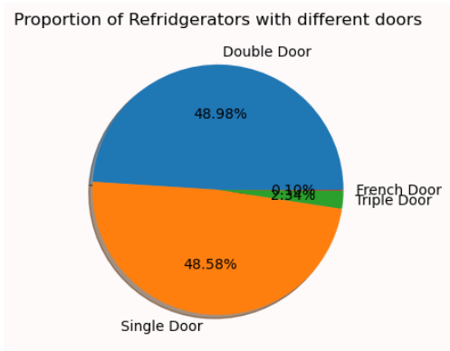
Data Analysis Using Visualizations
Univariate Analysis
Most refrigerators fall between 2-star and 4-star ratings.
The median rating is around 3 stars, indicating moderate energy efficiency across products.
Few refrigerators reach 5 stars, suggesting premium energy-efficient models are limited.
Consumers appear to prefer mid-range energy ratings over high-cost efficient models.
Double Door (~49%) and Single Door (~48%) together account for nearly the entire market.
Triple Door (~2%) and French Door (~0.1%) have extremely small shares.
This confirms that consumer preference is highly concentrated on affordable and practical models.

Slide 11
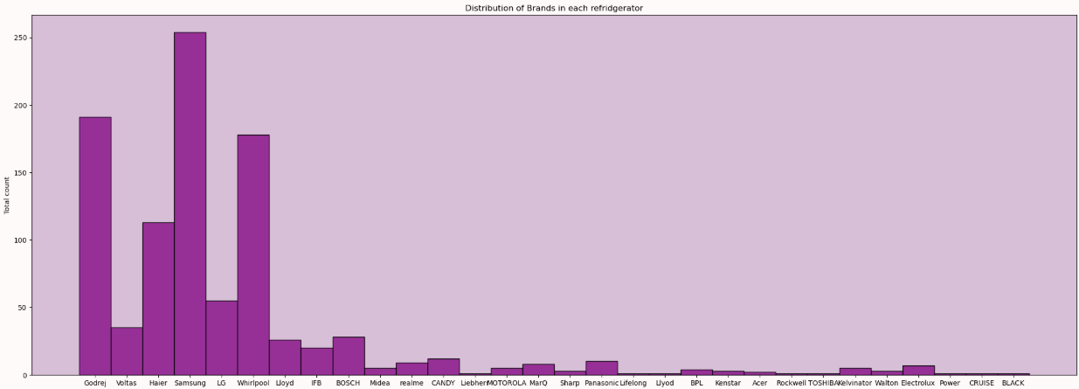
Samsung, LG, Whirlpool, Godrej, and Haier are the most dominant brands.
Some brands show very low product counts, indicating weak presence or niche targeting.
Market competition is led by a few strong multinational brands.
Smaller brands may struggle due to limited model variety or brand recognition.

Slide 12
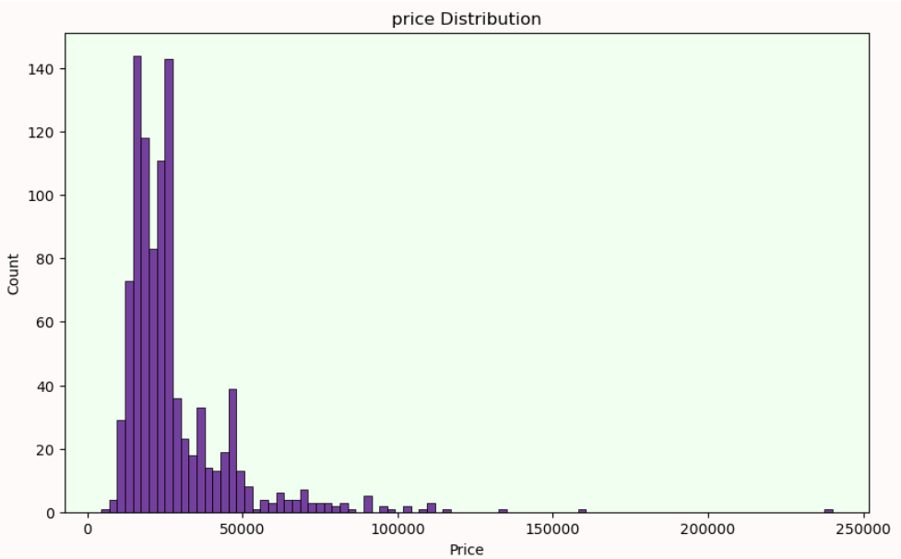
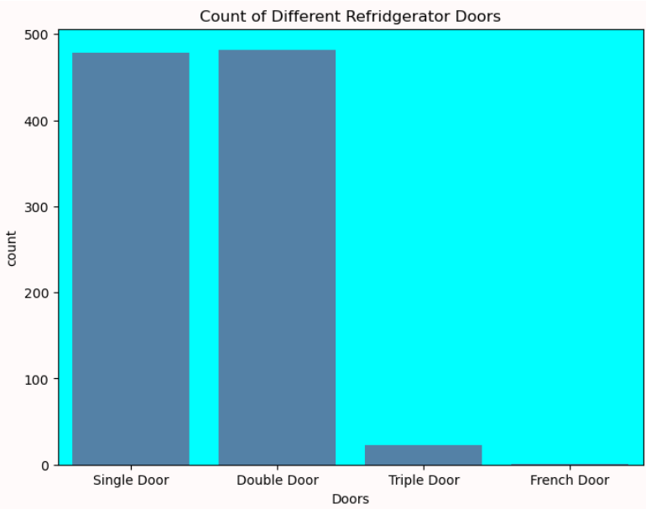
Double Door and Single Door refrigerators dominate the market, making up the majority of products.
Triple Door models are very limited, indicating lower demand or premium positioning.
French Door refrigerators are almost negligible, suggesting niche or high-end category.
Market demand strongly favors simpler and mid-range door configurations.
The price distribution is right-skewed, meaning most refrigerators are affordable, with fewer premium products.
The majority of refrigerators are priced between ₹15,000 and ₹45,000, targeting mid-range buyers.
A small number of models fall in very high price ranges, forming luxury outliers.
This suggests the market is mass-oriented with limited high-end offerings.

Slide 13
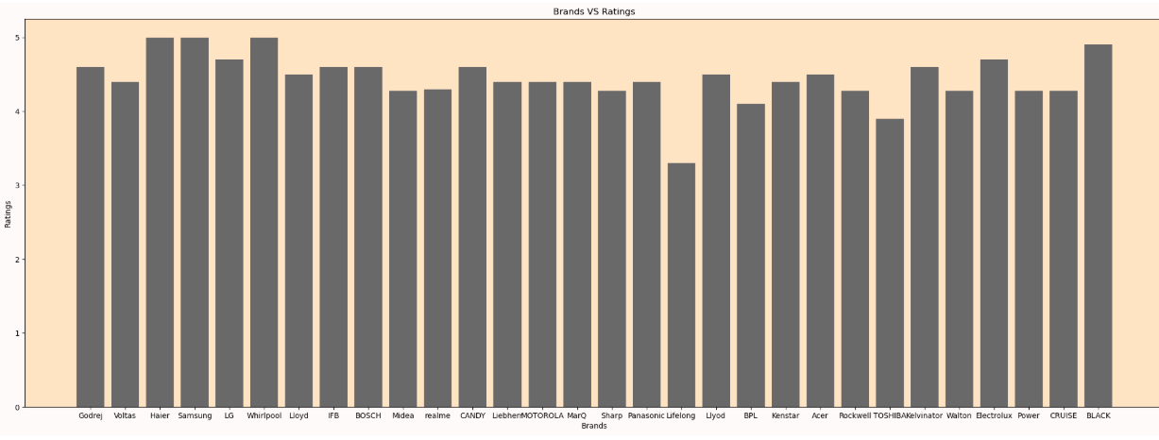
Bivariate Analysis
Most brands maintain ratings above 4.0, indicating overall strong customer satisfaction.
Premium brands such as Samsung, LG, Bosch, and Whirlpool show consistently high ratings.
A few brands display slightly lower ratings, indicating areas for quality improvement.
Brand reputation positively impacts customer trust and perceived reliability.

Slide 14
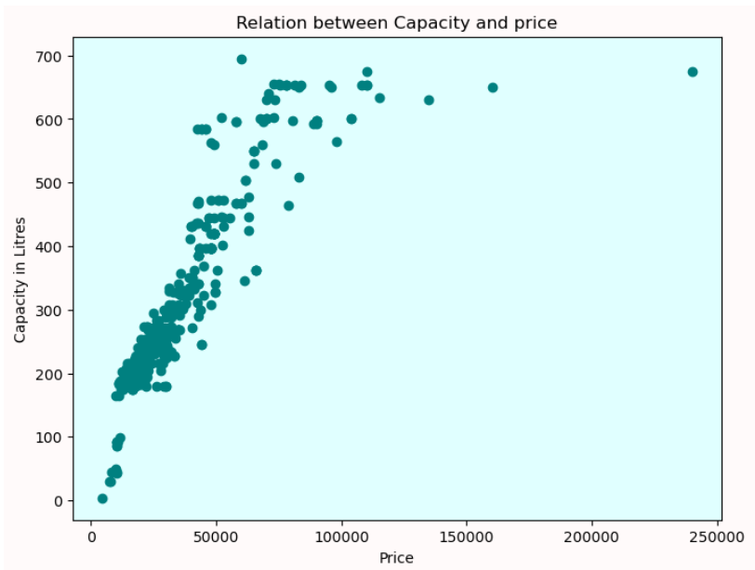
There is a clear upward trend showing price increases with capacity.
Most refrigerators fall between 1,50L–2,50L capacity and ₹15,000–₹60,000 price range, indicating the core market.
High-capacity refrigerators (500L+) enter premium price tiers, sometimes exceeding ₹100,000.
Outliers represent luxury or commercial-grade refrigerators.

Slide 15
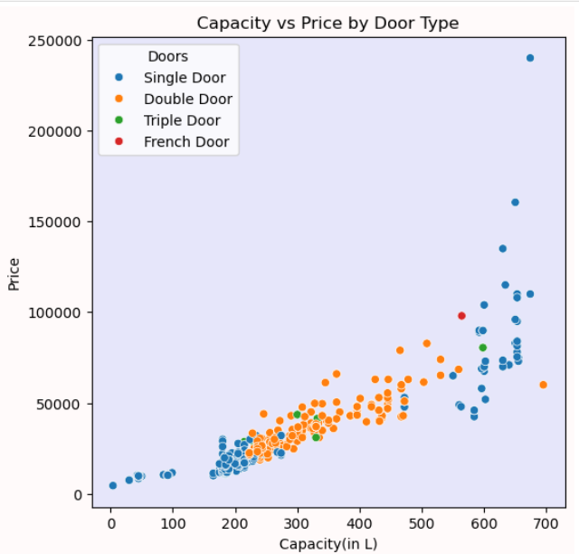
There is a strong positive relationship between capacity and price across all door types.
Double Door refrigerators dominate the mid-range capacity and price segment, making them the most popular choice.
Single Door refrigerators cluster in lower capacity and budget price ranges, suitable for small households.
Triple Door and French Door models appear in the high-capacity and premium price range, targeting high-end customers.
Premium outliers indicate luxury refrigerators with very high price and large storage.

Slide 16
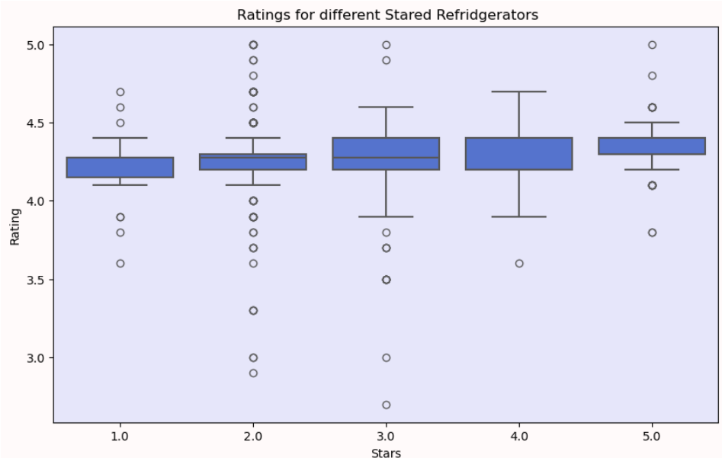
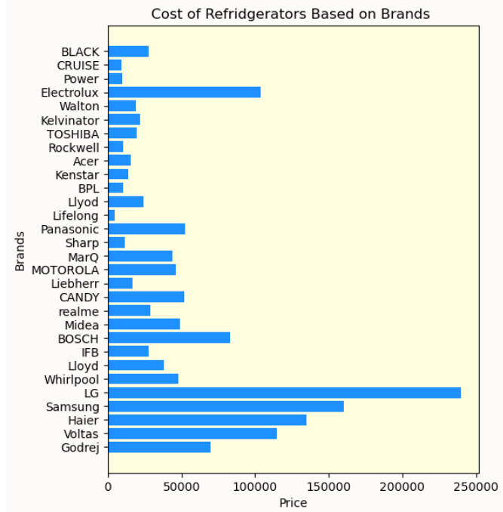
Samsung, LG, and Haier sell the most expensive refrigerators, reflecting premium product positioning.
Budget-friendly brands such as Voltas, Godrej, Lloyd, and IFB focus on lower-priced segments.
Some brands show very limited price ranges, indicating fewer premium offerings.
Most refrigerators fall between 2-star and 4-star ratings.
The median rating is around 3 stars, indicating moderate energy efficiency across products.
Few refrigerators reach 5 stars, suggesting premium energy-efficient models are limited.
Consumers appear to prefer mid-range energy ratings over high-cost efficient models.

Slide 17
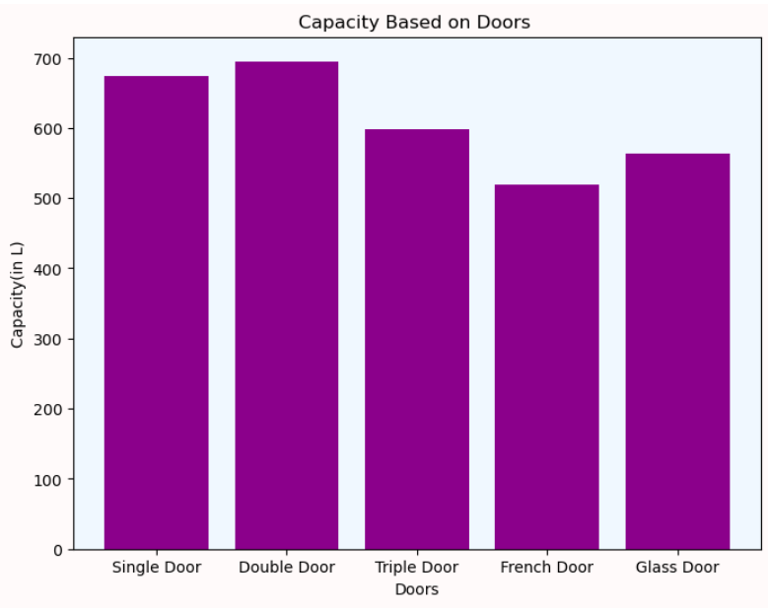
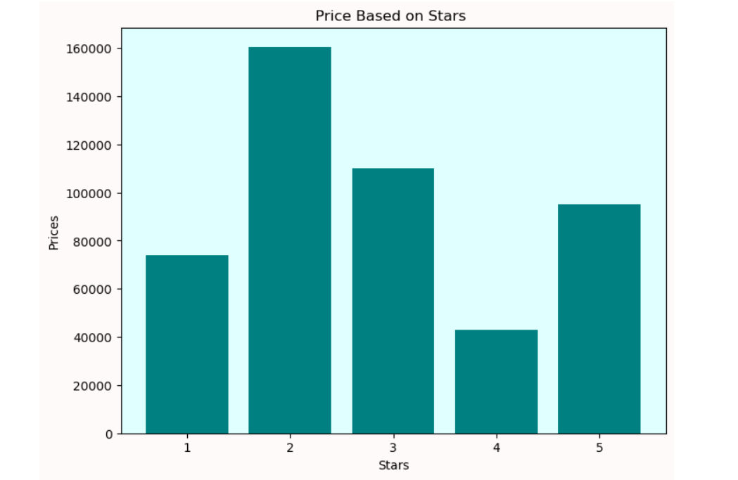
Double Door refrigerators have the highest average capacity, ideal for families.
Single Door models also show large capacity, but slightly less than double door.
French Door models show lower average capacity, possibly due to premium design trade-offs.
Glass Door refrigerators fall in mid-range capacity, likely targeting commercial or display use.
Door type strongly influences storage capacity and target user group.
2-star refrigerators show the highest price range, possibly due to high-capacity or premium older models.
4-star refrigerators appear to be the most affordable, offering strong energy efficiency at lower cost.
5-star models are priced moderately, balancing efficiency and cost.
Energy rating does not always directly correlate with price — capacity and brand also matter.

Slide 18
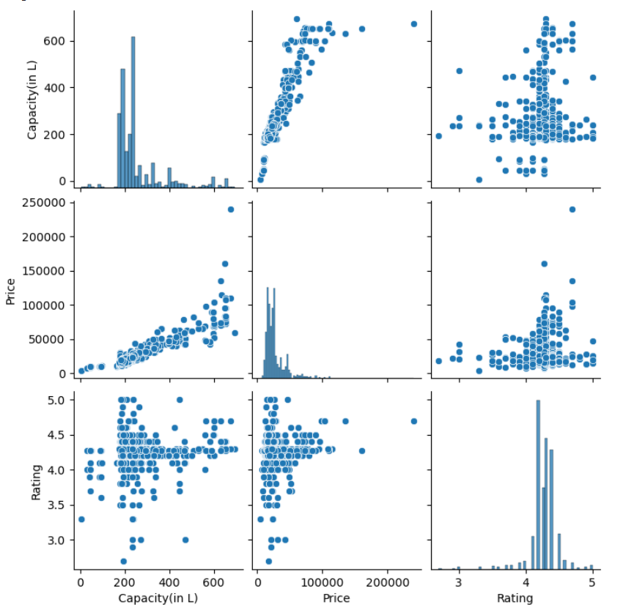
Multivariate Analysis
Price increases as capacity increases, showing a strong positive relationship.
Higher-capacity refrigerators tend to cost significantly more.
Ratings remain mostly between 3.5 and 4.5, showing overall good customer satisfaction.
Price does not strongly influence rating, suggesting users rate based on value rather than cost.
Some premium models have very high prices, indicating luxury or advanced features.

Slide 19
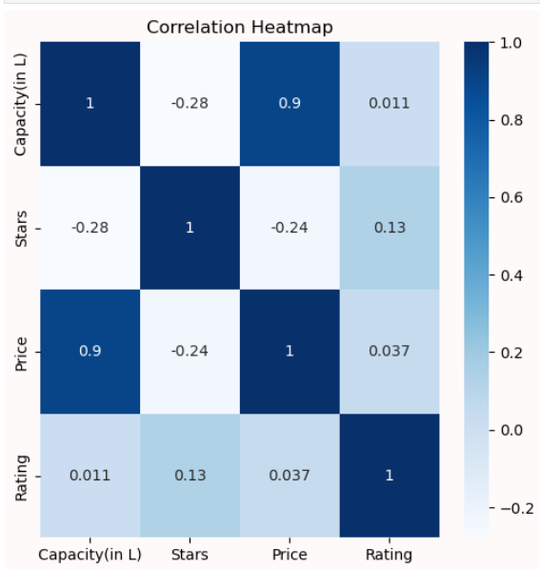
Capacity and Price show a very strong positive correlation (~0.90), confirming that bigger refrigerators cost more.
Stars have a weak negative correlation with Price (-0.24), meaning energy rating does not significantly increase price.
Rating has almost no correlation with Price or Capacity, suggesting customer satisfaction is independent of cost.
Capacity does not strongly affect Ratings, implying larger size does not guarantee better customer experience.

Slide 20
Conclusion
Successfully extracted real-time refrigerator data (brand, price, capacity, star rating, door type, compressor type, etc.) from an e-commerce platform using web scraping techniques, demonstrating practical data collection skills.
Data cleaning and preprocessing helped handle missing values, remove duplicates, and standardize formats, improving data quality for accurate analysis.
Exploratory Data Analysis revealed that price is strongly influenced by capacity, brand, and star rating, with higher energy-rated models generally costing more.
Most refrigerators listed fall into double-door and 3-star/4-star categories, showing consumer preference for balanced energy efficiency and storage capacity.
Premium brands tend to dominate the higher price segments, while budget brands focus on single-door and lower-capacity models.
Visualization techniques (pie charts, bar graphs, histograms) made it easier to identify trends in door types, price ranges, and rating distribution.

Slide 21

THANK YOU

